Slide 1
RAG

Slide 2
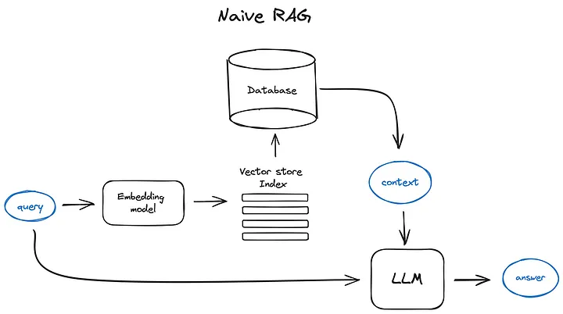
Docs
Chunk and vectorize

Slide 3
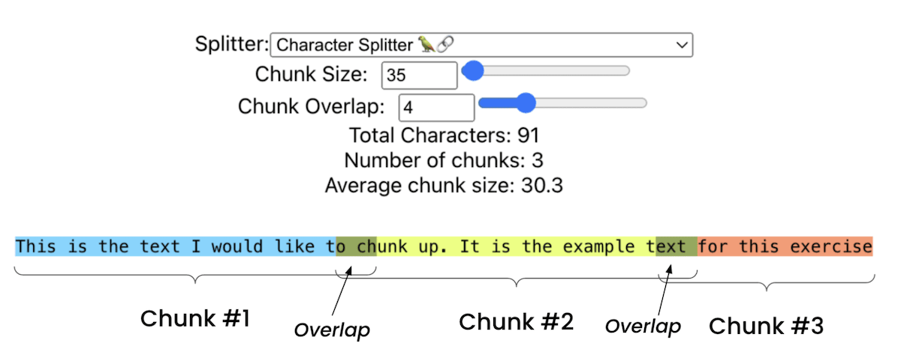
Chunking Text

Slide 4
Semantic Chunking
Overview: Semantic chunking involves dividing text based on meaning rather than fixed sizes. This technique ensures that each chunk represents a coherent piece of information.
Implementation: Calculate the cosine distance between sentence embeddings. If two sentences are semantically similar (below a certain threshold), they belong in the same chunk. This creates variable-length chunks based on the content's semantic structure.
Pros and Cons: Produces more coherent and contextually meaningful chunks, improving retrieval accuracy but requires forward passes through a BERT based encoder model which is more computationally intensive then simple chunking.

Slide 5
Vectorization
Purpose: After chunking, each text segment needs to be transformed into a numerical form that captures its meaning. This is what embeddings (vectorization) do — they map text into a high‑dimensional space where semantic similarity can be measured.
How it works:
Each chunk is passed through an embedding model.
The output is a dense vector (e.g., 768 or 1024 dimensions).
Similar chunks end up close together in this vector space.
Model choices:
General‑purpose language models (like OpenAI embeddings).
Search‑optimised models (e.g., bge‑large, E5 family) tuned for retrieval tasks.
Multilingual embeddings if your data spans multiple languages.

Slide 6
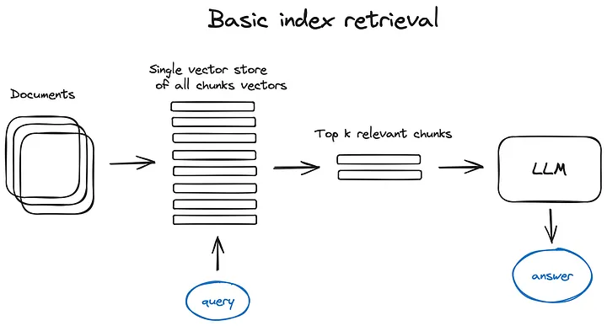

Slide 7
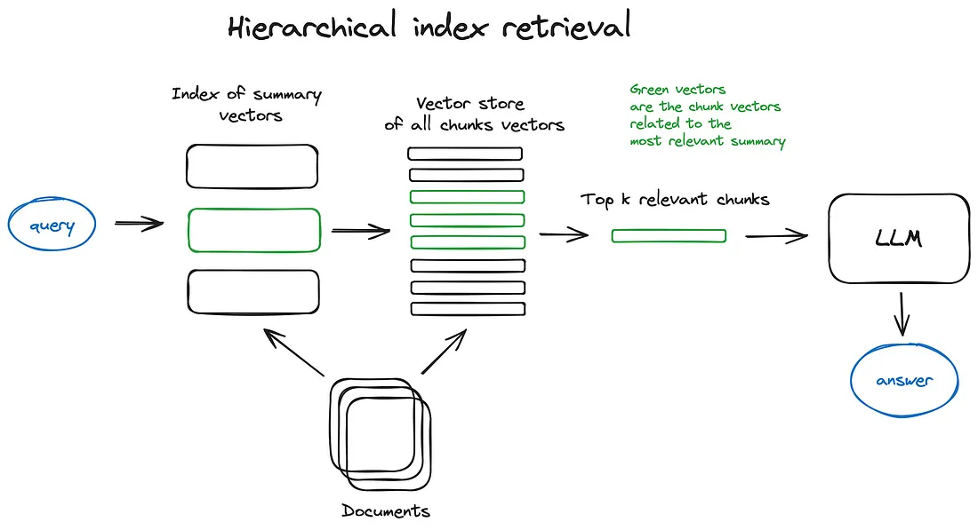

Slide 8
Challenges with RAG

Slide 9
No single document holds the answer
What nationality was James Henry Miller's wife?
James Henry Miller, better known by his stage name Ewan MacColl, was an English Folk singer….
Ewan MacColl was married to Peggy Seeger…
Ewan MacColl was an American
Solution: Multiple document retrieval hops

Slide 10
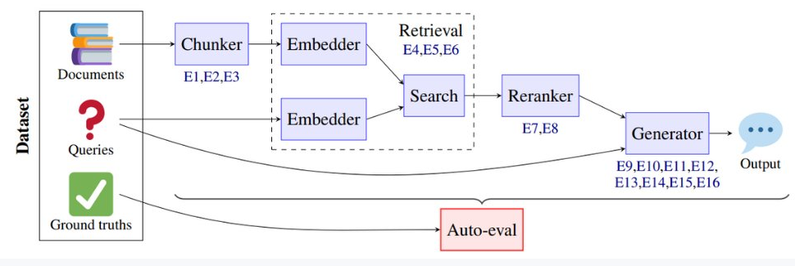
Retrieval/Ranking or chunking issues
RETRIEVAL
ERRORS
UNDER CHUNKING
OVER CHUNKING
CONTEXT MISMATCH
LOW RECALL
LOW PRECISION
ABSTENTION FAILURE
PARAMETRIC OVERRELIANCE
Lots of unrelated Miller namesake passages crowd the results, making matching harder

Slide 11
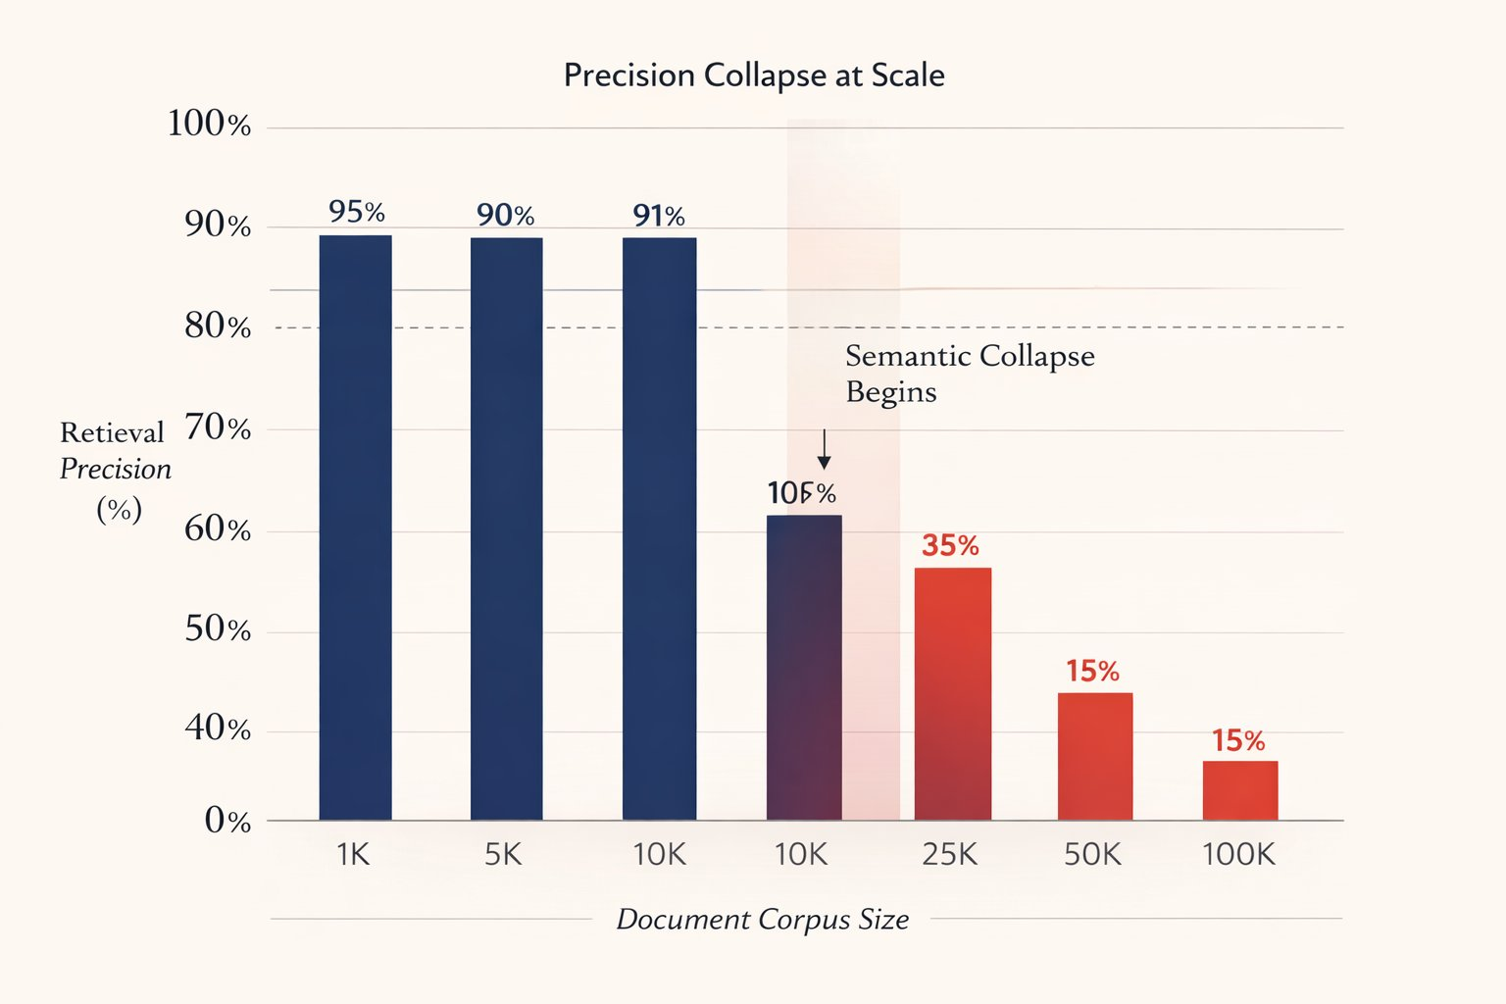

Slide 12
Techniques

Slide 13
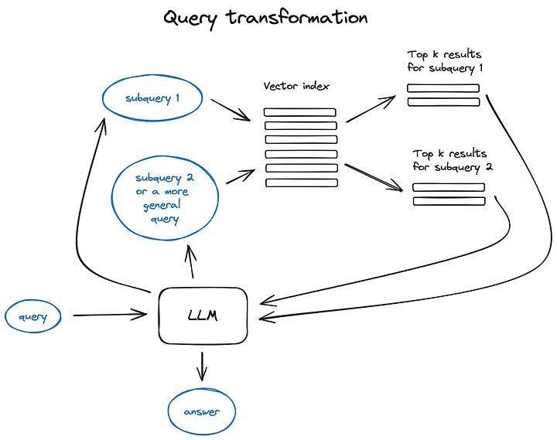
Query Transformation: Modify input to improve results

Slide 14
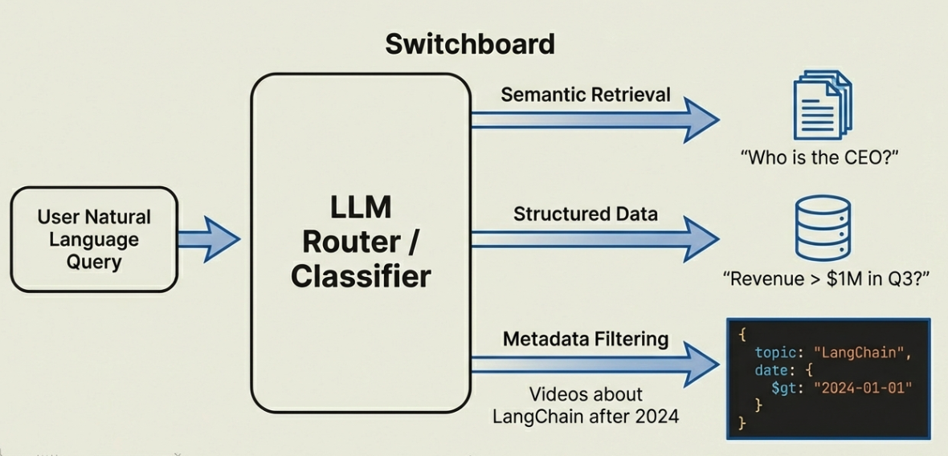
Intelligent Query Routing and response construction

Slide 15
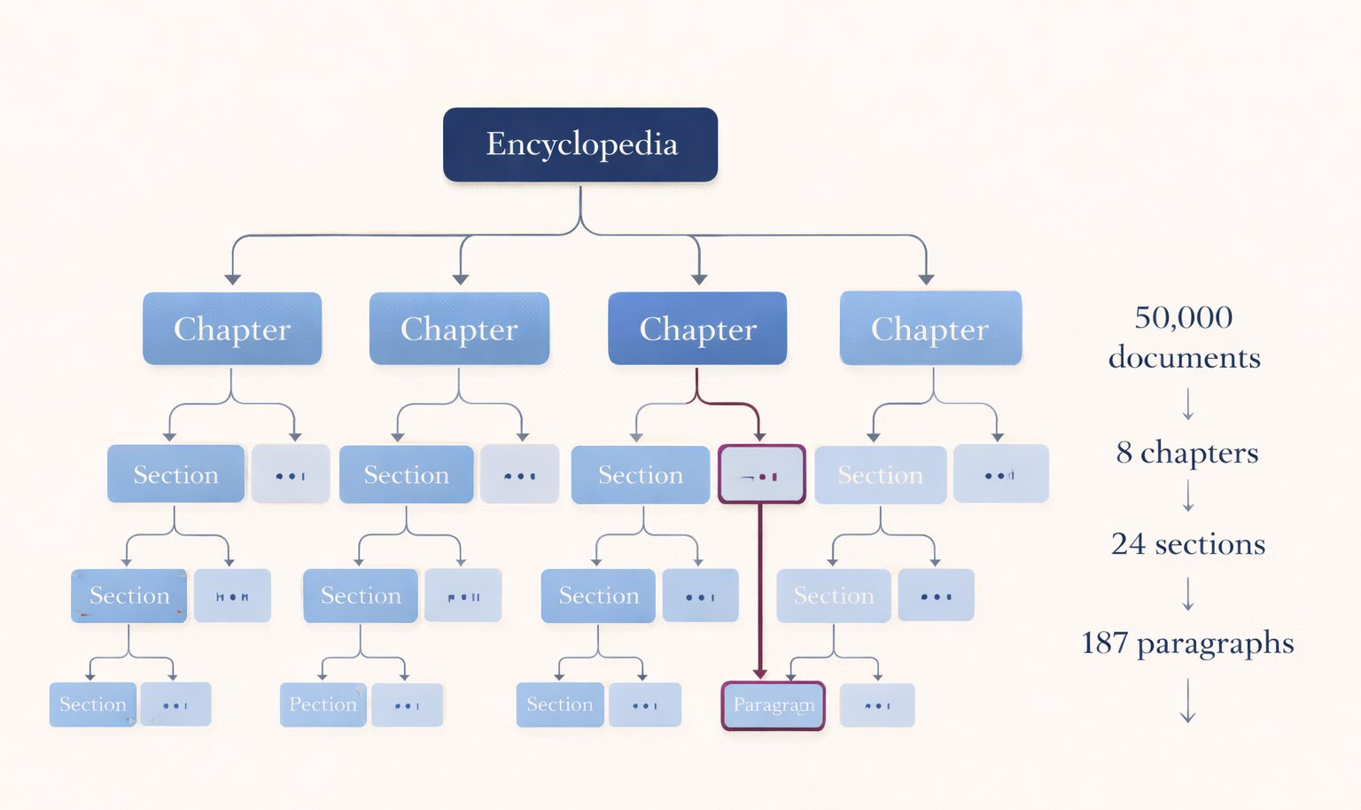
Reduce Search space :Hierarchical indexing and retrieval

Slide 16
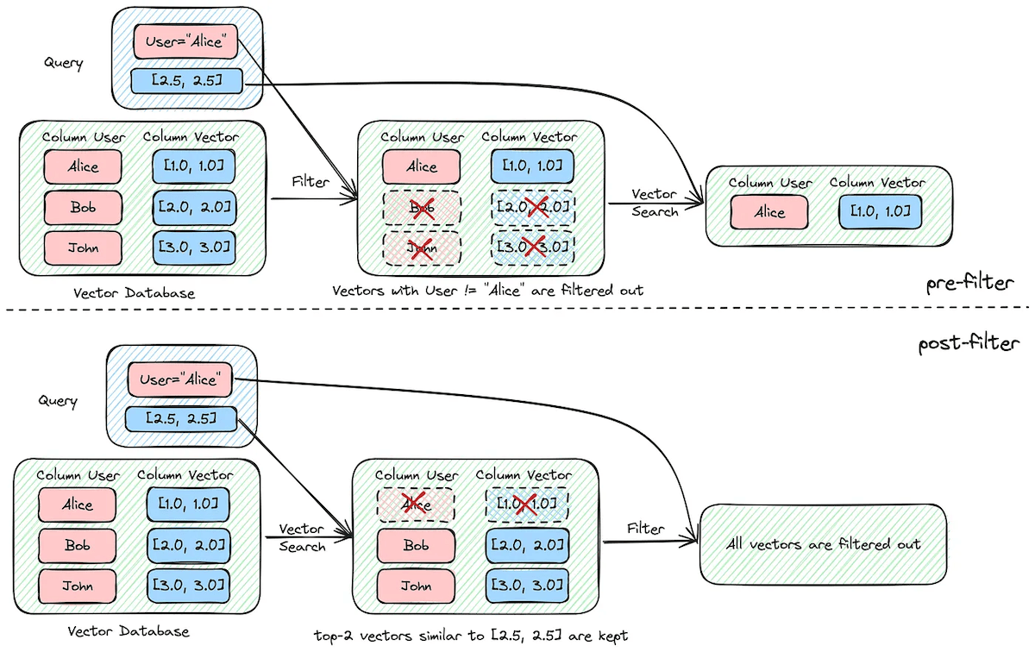
Leveraging Metadata: Filter and narrow search space

Slide 17
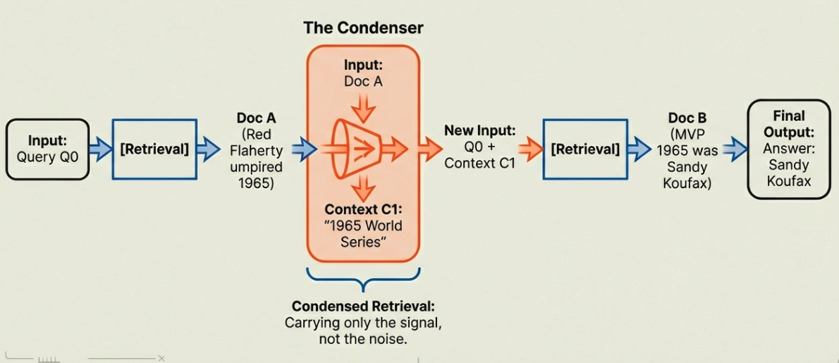
Multi Hop Reasoning

Slide 19
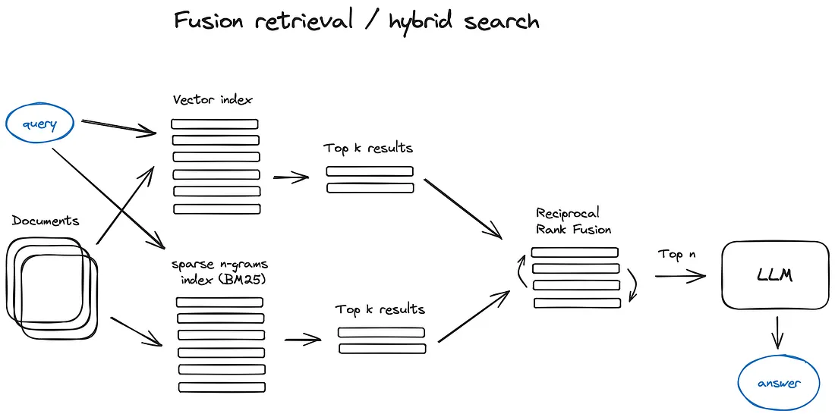
Search: Use hybrid search for better recall
Embedding based searches max out at a recall of .25

